Slide 1
WELCOME

Slide 2
Room Management Appliance System
Presented By:
Md. Rafikul Islam
ID: 151-35-1016

Slide 3
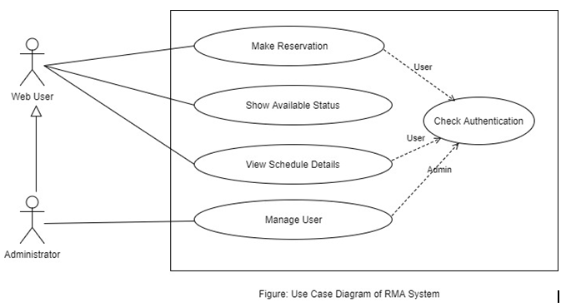
Use Case Diagram:

Slide 4
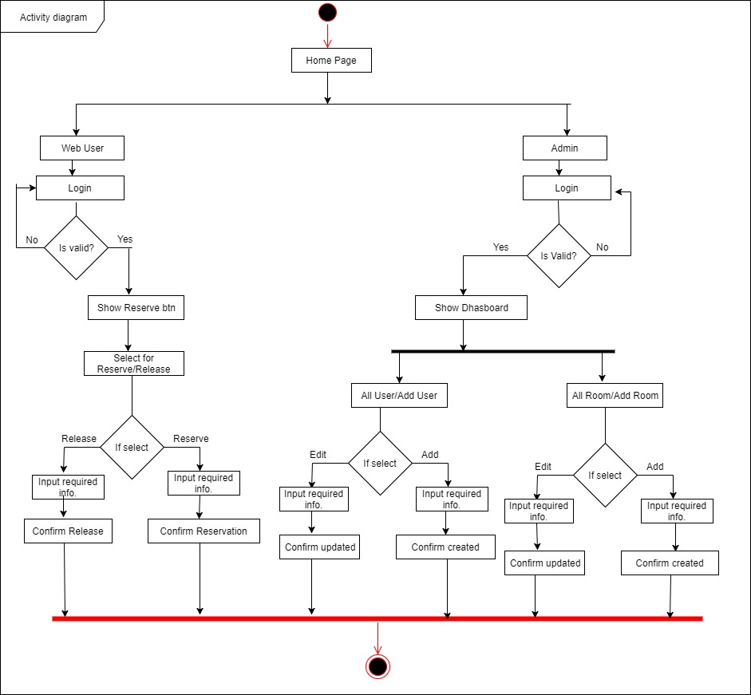
Activity Diagram:

Slide 5
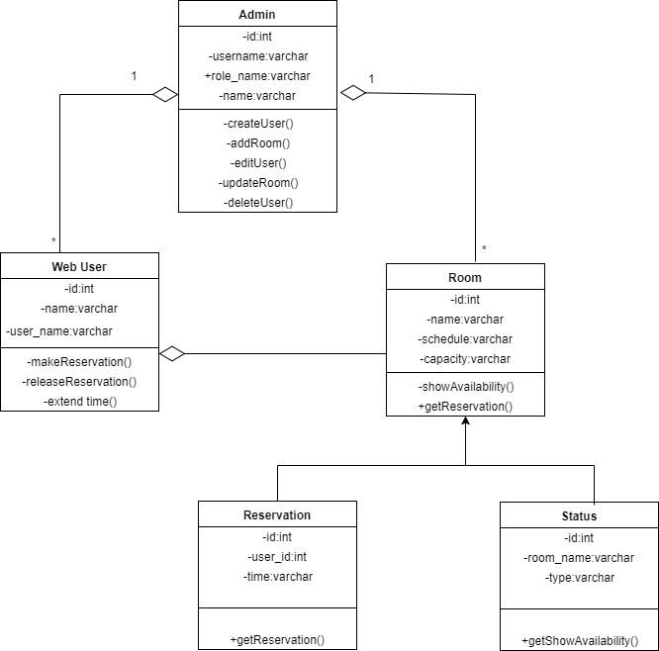
Class Diagram

Slide 6
Actor: Administrator
Login
View Web Users
Add Web Users
Delete Web Users
View All Rooms
Add Room Details
Edit Room Details

Slide 7
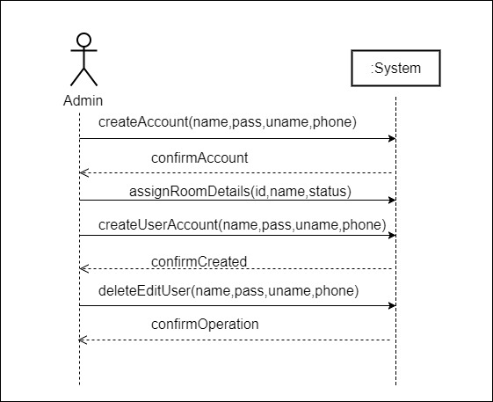
System Sequence Diagram: Admin

Slide 8
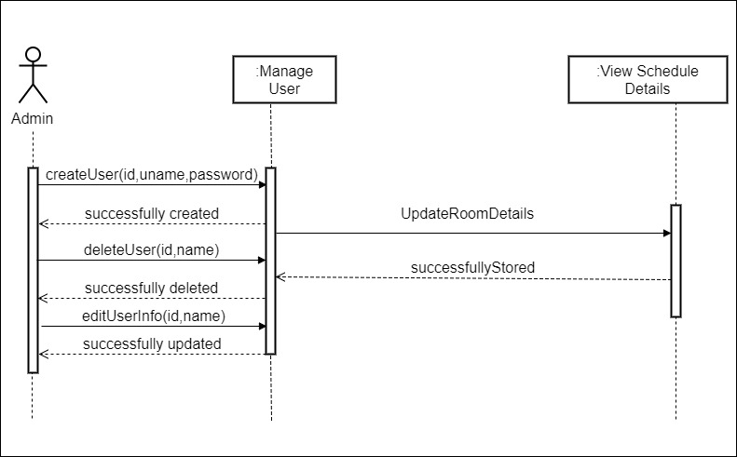
Sequence Diagram: Admin

Slide 9
Success And Alternative Scenario:
Success Scenario | Alternative Scenario
Admin will login through username and password. Website carries his username that is why he can show the registered user list. He can add/edit/delete user and provide the register user their username and password. He can upload room & provide availability status. | 1.1 Confirm the Admin login. 2.1 Show the user list to admin. 3.1 Provide add/edit/delete opportunity to admin of any user profile. 4.1 Provide upload form of room & status.

Slide 10
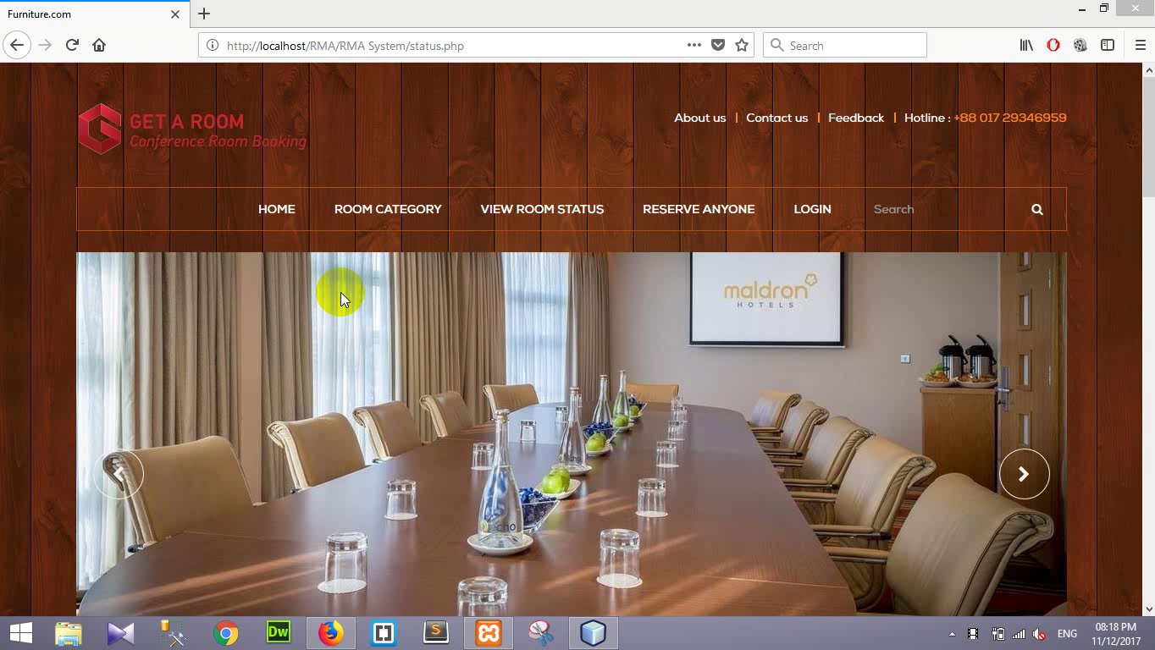
Video

Slide 11
Thank You

